Slide 1
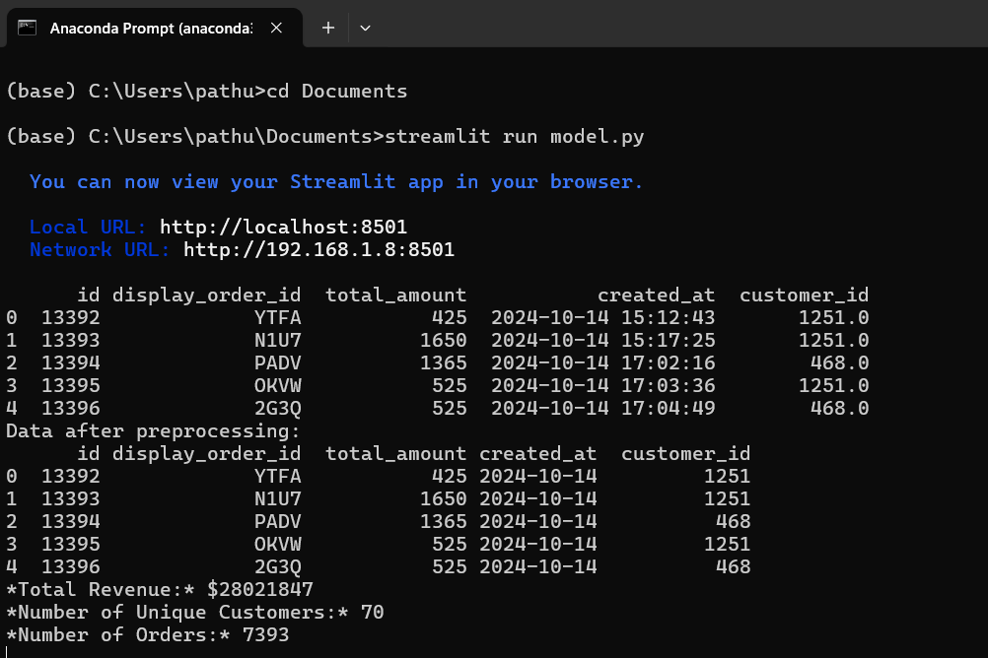
Running the Streamlit App
Open Anaconda Prompt:
Go to your Start menu, search for "Anaconda Prompt," and open it.
2. Navigate to the Folder:
Use the cd command to change directories to where model.py is located.
Example: If your file is in the Documents folder, enter:

Slide 2
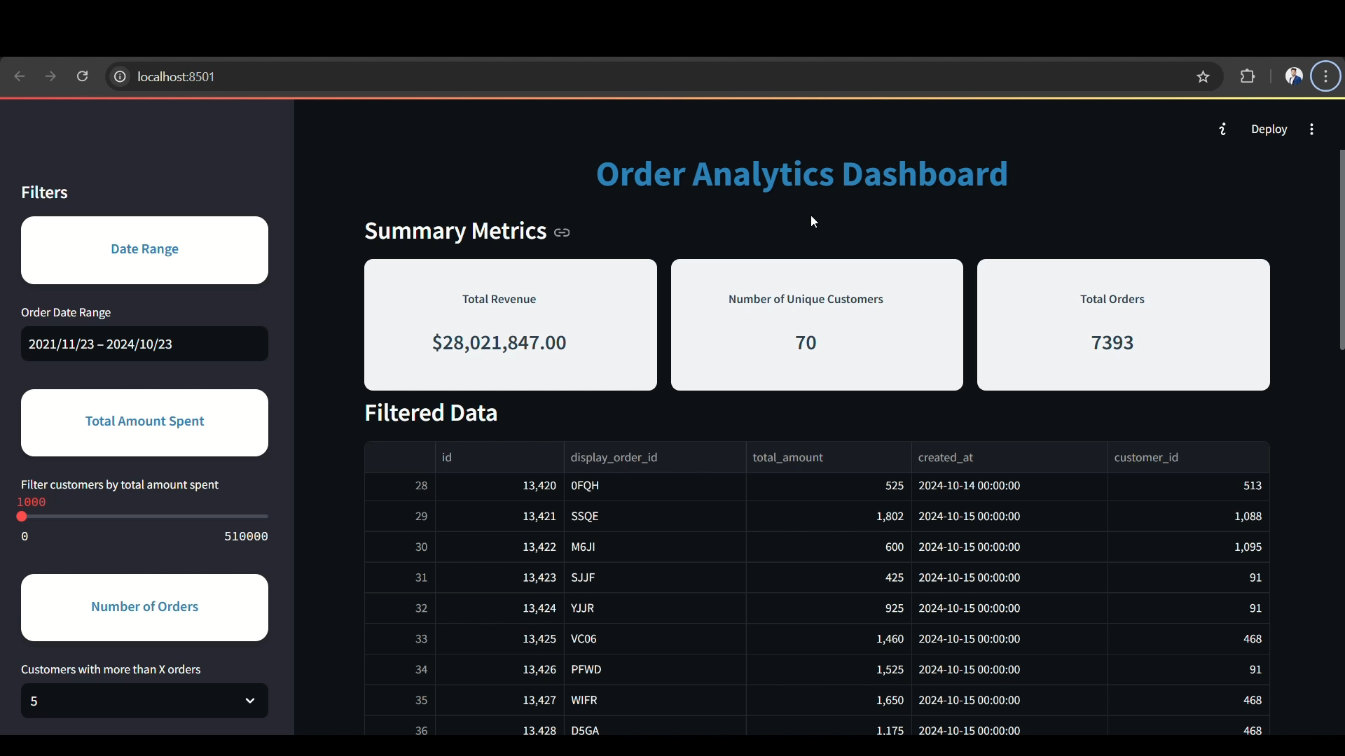
You can explore the interactive Streamlit dashboard by watching the attached video. Alternatively, you can run the Python file directly by downloading it from the GitHub repository: Data Engineering Assessment.

